Slide 1


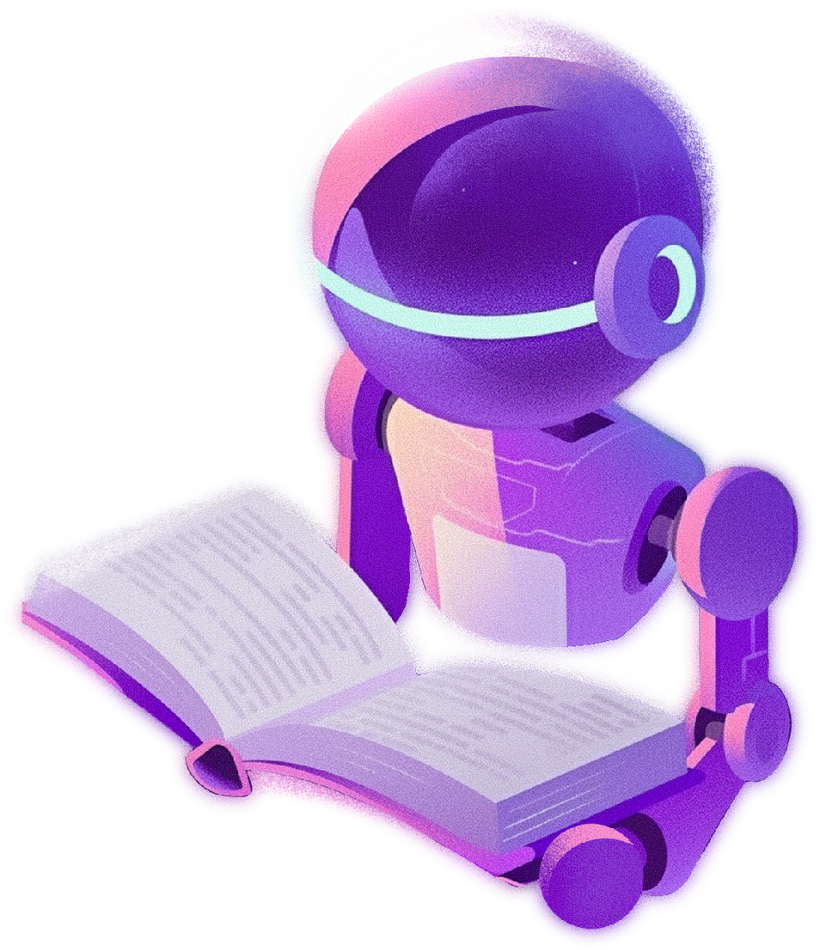



COMPANY NAME
ARTIFICIAL INTELLIGENCE
AND ITS INFLUENCE
Everyday Uses and Future Possibilities
Feb 00, 2026

Slide 2

INTRODUCTION
Artificial Intelligence (AI) has advanced at a remarkable pace, transforming both daily life and multiple industries. From voice assistants to driverless cars, AI is redefining how people engage with technology. This presentation highlights AI’s role in everyday activities and explores its potential impact on the future.

Slide 3

ARTIFICIAL INTELLIGENCE
Virtual Assistants
AI-powered assistants support users by managing schedules, finding information, and operating smart devices. Voice recognition technology enhances accessibility and convenience. Example: mobile voice assistants.
IN DAILY LIFE
Smart Home Technology
AI works alongside IoT devices to automate household functions. Examples: smart thermostats, facial-recognition security cameras, and automated lighting.

Slide 4



ARTIFICIAL INTELLIGENCE
Virtual Assistants
AI-powered assistants support users by managing schedules, finding information, and operating smart devices. Voice recognition technology enhances accessibility and convenience. Example: mobile voice assistants.
IN DAILY LIFE
Smart Home Technology
AI works alongside IoT devices to automate household functions. Examples: smart thermostats, facial-recognition security cameras, and automated lighting.

Slide 5
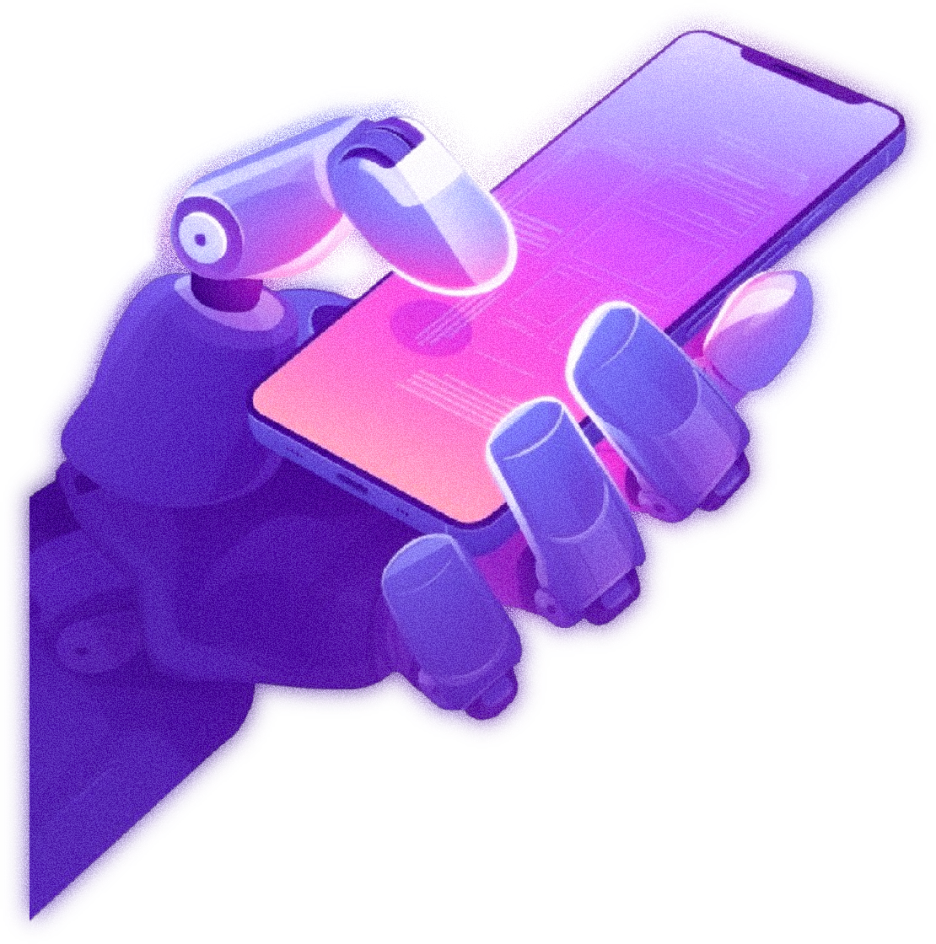
Autonomous Vehicles
ARTIFICIAL INTELLIGENCE
AI powers self-driving cars, minimizing human mistakes and enhancing road safety. By analyzing real-time data from sensors and cameras, advanced systems can navigate efficiently.
IN DAILY LIFE
AI in Customer Service
Chatbots and virtual assistants improve customer interactions by delivering round-the-clock support. Additionally, AI-based sentiment analysis allows companies to better interpret customer feedback.

Slide 6
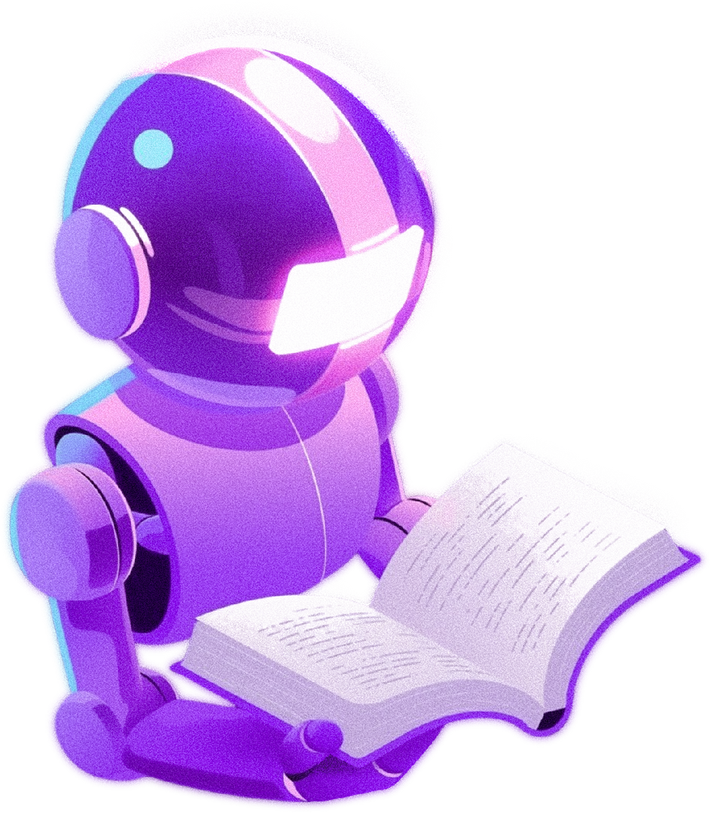

ARTIFICIAL INTELLIGENCE
Workplace Automation
AI will handle repetitive tasks, giving humans more time for creativity and strategy. Industries such as logistics, law, and finance will benefit significantly.
FUTURE POTENTIAL OF
Education
AI-driven tutors and adaptive learning platforms will personalize the educational experience.

Slide 7
FUTURE POTENTIAL OF
Ethical Considerations and Challenges
AI also raises concerns, including job loss, data privacy, and algorithmic bias. Developing ethical standards and regulatory policies is vital for responsible growth.
ARTIFICIAL INTELLIGENCE
Scientific Research
AI speeds up drug development, genome studies, and supports climate modeling and space research through advanced machine learning algorithms.

Slide 8

IMPACT
ETHICAL ISSUES AND CHALLENGES
AI brings forth concerns such as workforce replacement, protection of personal data, and biased decision-making. This highlights the need for ethical AI design and strong regulatory guidelines.

Slide 9
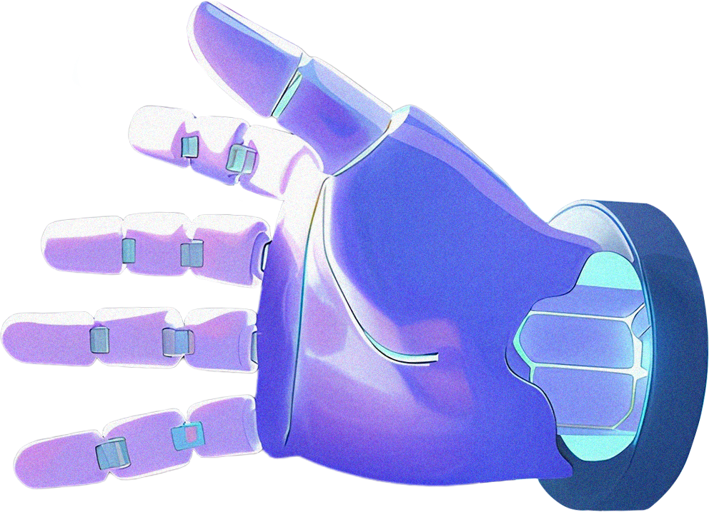
CONCLUSION
Artificial Intelligence has become an inseparable part of modern life, delivering significant advantages while also presenting obstacles. Its future promises great advancements in industries, scientific research, and everyday convenience.
As AI continues to progress, prioritizing ethics and responsible application will be essential in creating a better future for society

Slide 10


THANK YOU
FOR YOUR ATTENTION!
+123-456-7890
hello@world.com

